Slide 1
Linear model theory
Interactions

Slide 2
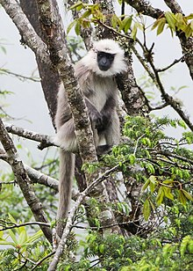
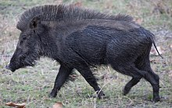
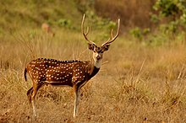
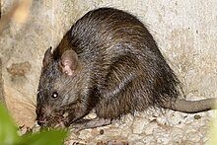
The question
How much does the density of animals impact crop yields?
Do some species cause more damage at the same density?
Different species damage plants in different ways
Different species can eat more or less crops
How would you attempt to answer this?

Slide 3
The question
Experimental approach
Four Indian herbivores
Measure yield of crop (response)
Controlled density of each species
We want to understand how each species and their densities influences crop yield
So, crop ~ species + density?
Species
Crop Yield
Density

Slide 4
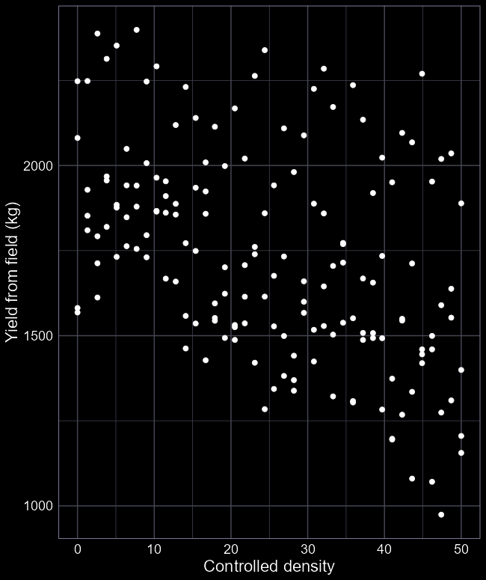
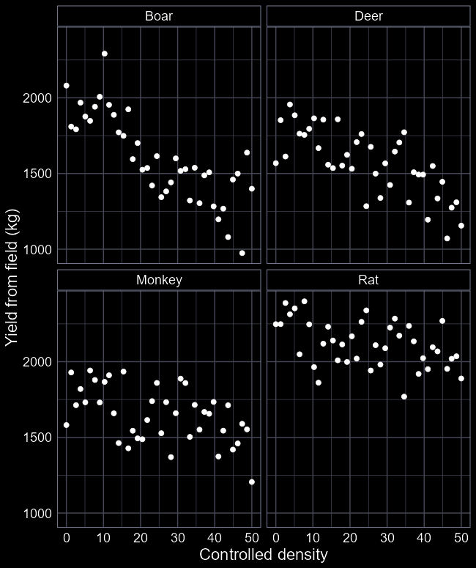
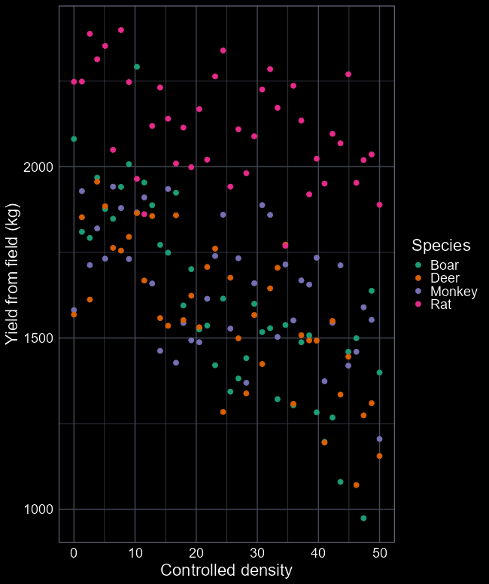
The data
As always start with EDA:
Notice anything weird?
Any surprises or concerns?
Is this the best way to visualise the data?
Our question is if the relationship differs between species
We can show this with colour
Or with facets (clearer?)

Slide 5
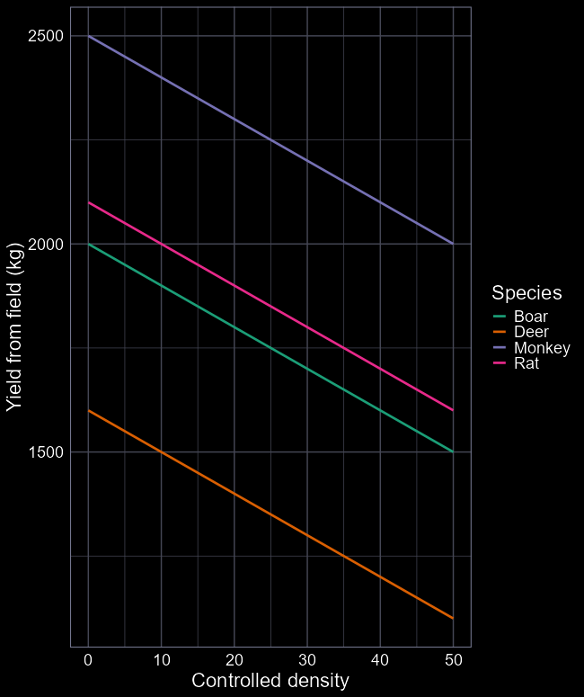








What might the results look like?
$$β_{2}$$
crop ~ species + density
$μ=β_{0}+β_{1}D_{i}+β_{2}M_{i}+β_{3}R_{i}+β_{4}Dens_{i}$
By including species, we allow for each species to have their own intercept ($β_{0,…,3})$
But we only have a single parameter to describe density, so all species have the same slope ($β_{4}$)
The lines will always be parallel
Does that make biological sense, and does it answer our question?
$$β_{4}$$
$$β_{3}$$
$$β_{0}$$
$$β_{1}$$
$$β_{4}$$
$$β_{4}$$

Slide 6
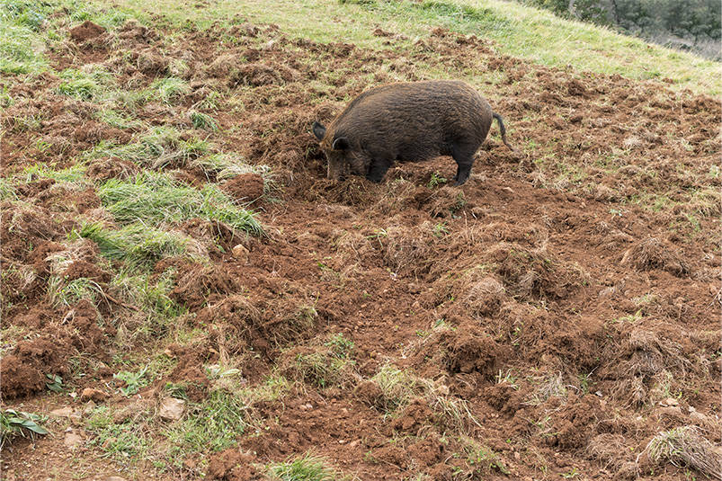
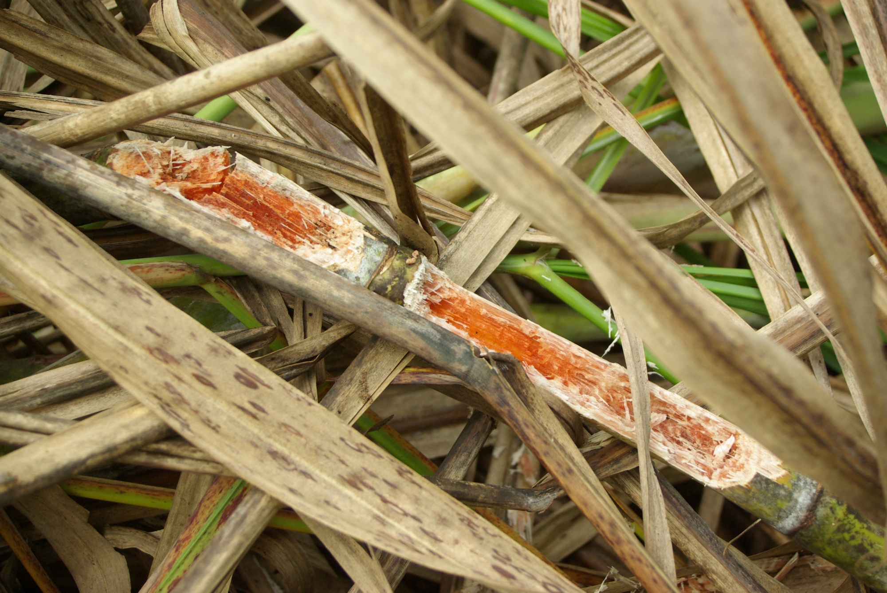
Biological sense?
Species clearly differ
The damage done by each species clearly differ
One boar eats a lot more than one rat
Having 1,000 boar in your field is not the same as 1,000 rats

Slide 7

How do we say 1 rat $≠$ 1 boar?

Slide 8

Is my coffee sweet?
Using only the following information, tell me if my cup of coffee is sweet or not

Slide 9
Is my coffee sweet?
I stir my coffee with a spoon

Slide 10
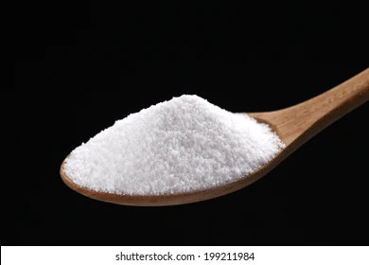
Is my coffee sweet?
I add sugar to my coffee

Slide 11
Is my coffee sweet?
Sometimes I add sugar to my coffee
Sometimes I stir my coffee

Slide 12
Is my coffee sweet?
I have added sugar to my coffee
And at the same time
I have stirred the coffee
and

Slide 13
Is my coffee sweet?
To answer question you need to know both pieces of information
But just knowing that sometimes I stir and sometimes I add sugar doesn’t actually help very much
We need to know if both adding sugar and stirring occurred at the same time
How do we tell the model this?

Slide 14
What is an interaction?
Will my tea be sweet?
Sweet ~ sugar + stir
The model doesn’t know that both need to occur at the same time
What if I stirred, but didn’t add sugar?
Treats both variables as being independent of each other
Maybe sweet?
Maybe sweet?
Not Sweet
Not Sweet

Slide 15
What is an interaction?
Interactions specify that an outcome is a result of specific combinations of more than one variable
The effectiveness of a covariate, depends on another covariate
Sweet ~ sugar * stir
Sweet
Not Sweet
Not Sweet
Not Sweet

Slide 16
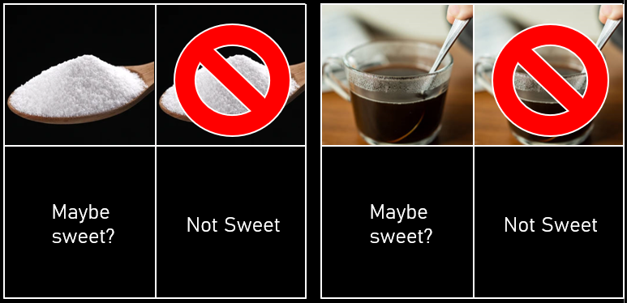
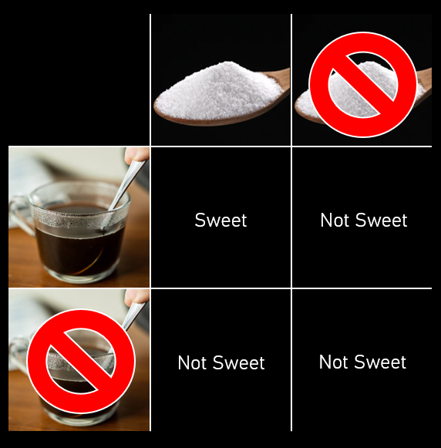

Two ways to specify interactions
The “formal” option
Sweet ~ sugar + stir
+ sugar : stir
$μ_{i}=β_{0}+β_{1}×S_{i}+β_{2}×T_{i}$
$+ β_{3}×S_{i}×T_{i}$
The “shortcut” option
Sweet ~ sugar * stir
$μ_{i}=β_{0}+β_{1}×S_{i}+β_{2}×T_{i}$
$+ β_{3}×S_{i}×T_{i}$

Slide 17
How do we say 1 rat $≠$ 1 boar?

Slide 18
Species
Crop Yield
Density

Slide 19
The question
How much do species impact crop yields?
We want to use an interaction to specify that the impact of density on yield differs between species:
crop ~ species * density
Species
Crop Yield
Density

Slide 20
species * density
We expand on species + density
By using an interaction
Each species’ intercept can still be different
But the relationship with density can also be species specific

Slide 21
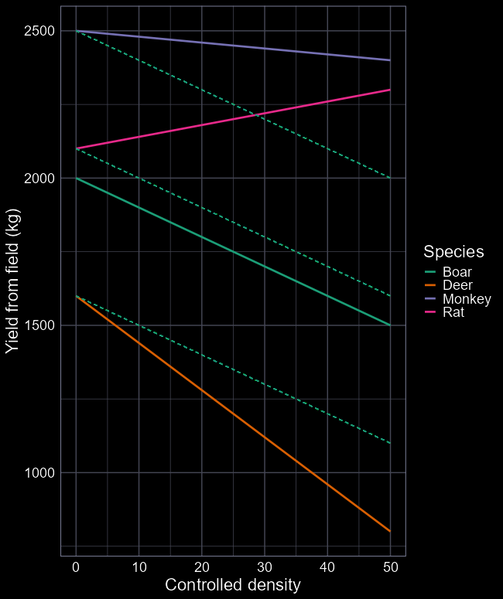
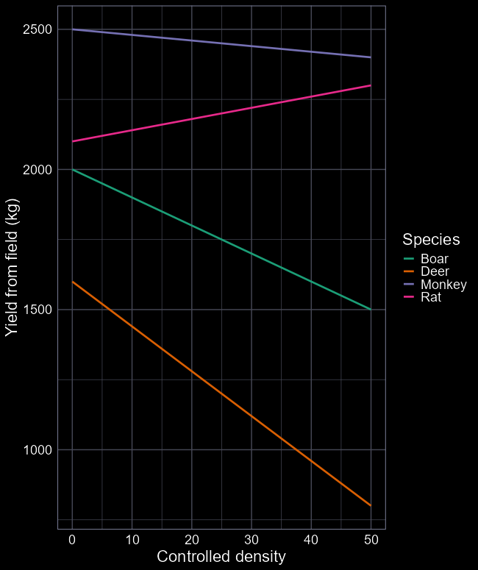



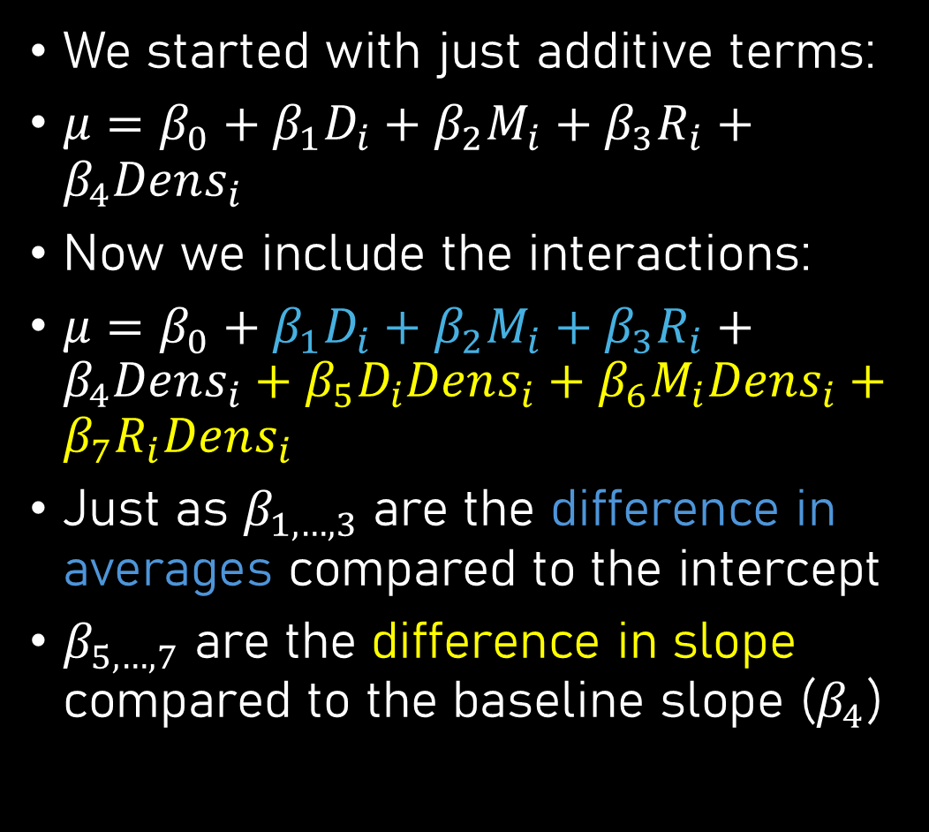





Interactions
$$β_{2}$$
$$β_{6}$$
We started with just additive terms:
$μ=β_{0}+β_{1}D_{i}+β_{2}M_{i}+β_{3}R_{i}+β_{4}Dens_{i}$
Now we include the interactions:
$μ=β_{0}+β_{1}D_{i}+β_{2}M_{i}+β_{3}R_{i}+β_{4}Dens_{i}+β_{5}D_{i}Dens_{i}+β_{6}M_{i}Dens_{i}+β_{7}R_{i}Dens_{i}$
Just as $β_{1,…, 3}$ are the difference in averages compared to the intercept
$β_{5,…,7}$ are the difference in slope compared to the baseline slope ($β_{4}$)
$$β_{7}$$
$$β_{3}$$
$$β_{0}$$
$$β_{1}$$
$$β_{4}$$
$$β_{5}$$

Slide 22
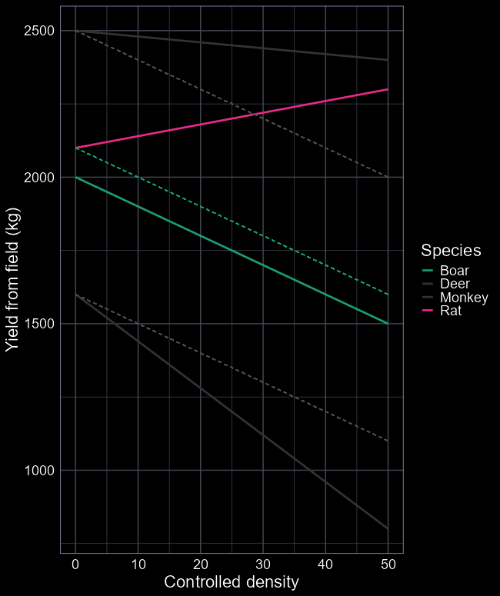









Quiz
$$β_{2}$$
$$β_{6}$$
Starting with our equation:
$μ=β_{0}+β_{1}D_{i}+β_{2}M_{i}+β_{3}R_{i}+β_{4}Dens_{i}+β_{5}D_{i}Dens_{i}+β_{6}M_{i}Dens_{i}+β_{7}R_{i}Dens_{i}$
Assume we have 5 Rats in the field
$R_{i}=1$ (for “Yes” this observation is Rat)
$Dens_{i}=5$ (density is 5)
$μ= β_{0}+β_{1}×0+β_{2}×0+β_{3}×1+β_{4}×5+β_{5}×0×5 +β_{6}×0×5+β_{7}×1×5$
$β_{0}+β_{3}×1+ β_{4}×5+β_{7}×1×5$
$$β_{7}$$
$$β_{3}$$
$$β_{0}$$
$$β_{1}$$
$$β_{4}$$
$$β_{5}$$

Slide 23

Quiz
Assume we have 15 Monkeys
What is the “simplified” equation?
$μ=β_{0}+β_{1}D_{i}+β_{2}M_{i}+β_{3}R_{i}+β_{4}Dens_{i}+β_{5}D_{i}Dens_{i}+β_{6}M_{i}Dens_{i}+β_{7}R_{i}Dens_{i}$
$μ=β_{0}+β_{1}×15+β_{2}×1+β_{4}×15+β_{6}×1×15$

Slide 24

Model fitting
The background machinery is the same as always
R tweaks the parameter values of our equation, so that the idealised $Normal$distribution overlaps the real data as close as possible
(It becomes a real pain to visualise with complex models)
So what do we learn?

Slide 25
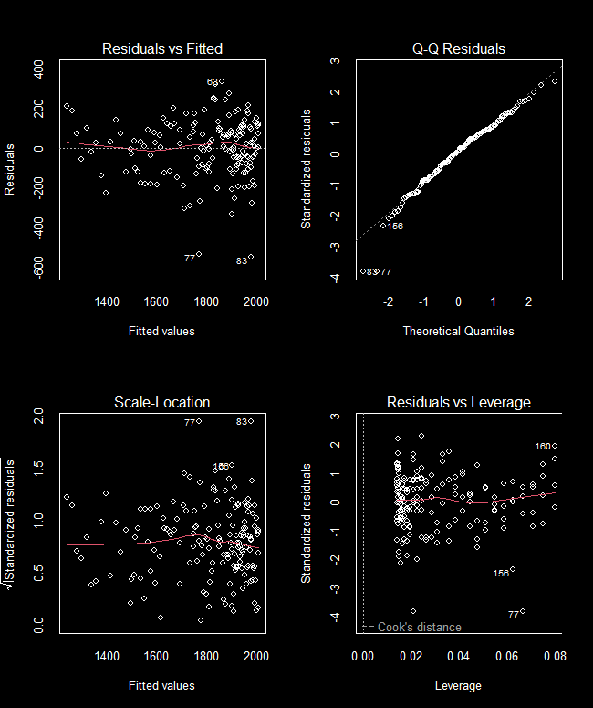
Diagnose
When running models with lots of explanatory variables, these diagnostic figures become incredibly valuable
Condense information down to be digestible
All four plots look great
On to interpretation!

Slide 26
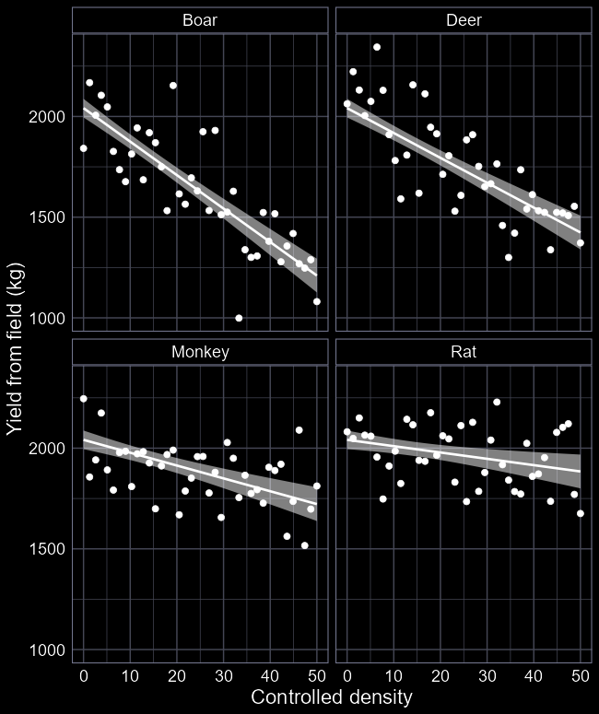
What do we learn?
Coefficients:
Estimate Std. Error
(Intercept) 2032.722 46.980
speciesDeer 78.767 66.439
speciesMonkey -47.966 66.439
speciesRat 3.685 66.439
density -16.371 1.617
speciesDeer:density 1.943 2.287
speciesMonkey:density 11.666 2.287
speciesRat:density 13.376 2.287
Which species is acting as our (Intercept)?
What yield do we expect for Deer when density is zero?
Is there meaningful difference in
Does that make biological sense?
Which species lowers yield the most?
Do any species increase yield?

Slide 27
Advice to farmers?
Main species of concern are clearly boar
Rats are not a problem
Focus efforts to keep boars out of field

Slide 28
A complication
This data comes from an experiment
Great right?
Any limitations?
How often do you get 50 individuals of each species?
What kind of densities do the different species occur at?
https://www.youtube.com/watch?v=zWVw-j8eYSk
What if we reran the experiment but used sensible range of densities?

Slide 29
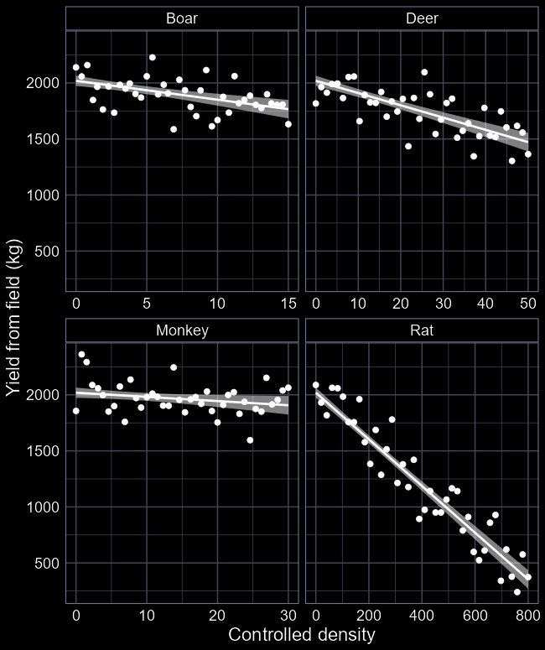
Advice to farmers, now?
With a more biologically sensible experimental design, we learn:
Rats are the biggest problem by far
Per individual, they don’t do much to yield
But they can reach insanely high densities
“Quantity over quality”
Focus efforts to reduce rat density

Slide 30
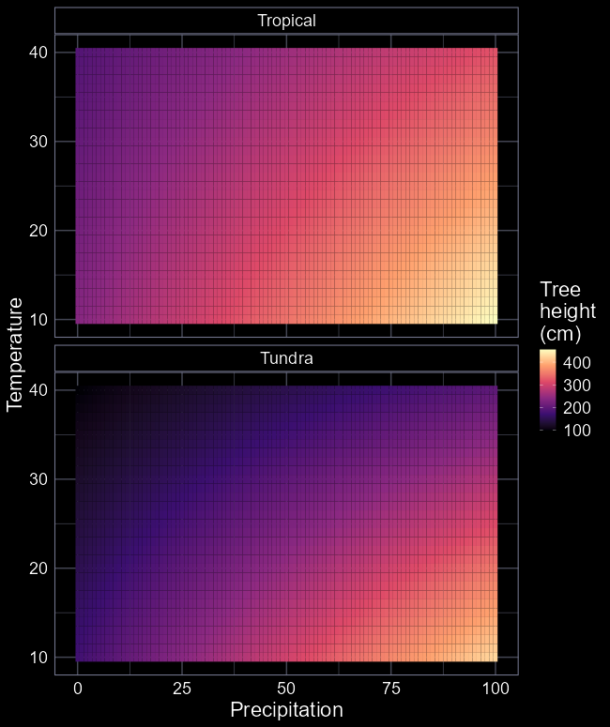
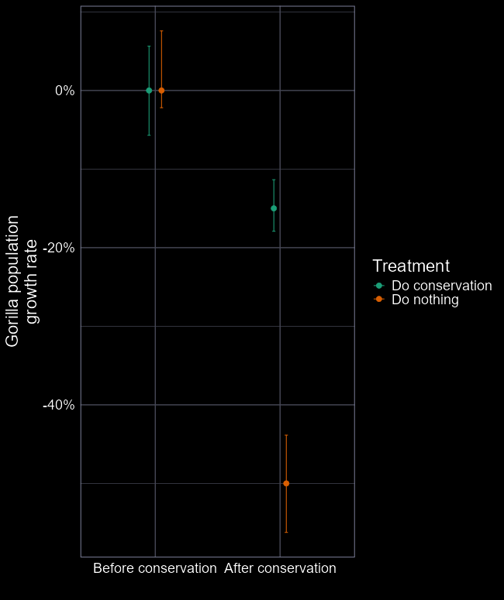
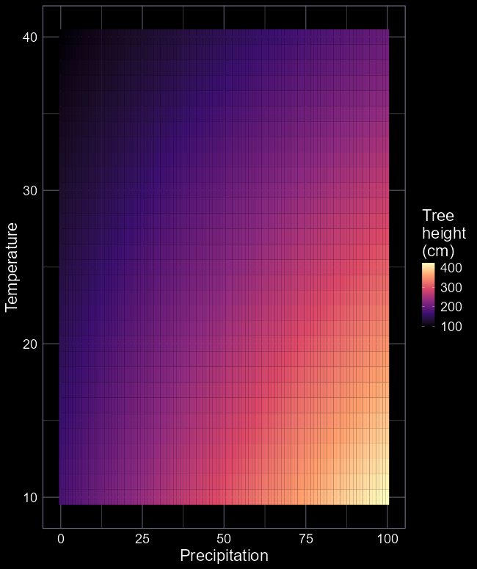
Flavours of interactions
In the previous example we used an interaction between a categorical and a continuous
But you can have interactions between:
Two categorical variables
Two continuous variables
Or interactions with more than two variables
For example, two continuous and one categorical

Slide 31
Warning
Interactions are incredibly expensive
The number of parameters can quickly get out of control
Especially true for categorical variables
Gorilla example needs 4 parameters
The 3-way example needs 8 parameters
Interactions require sample sizes up to 16 times larger to fit

